Slide 1
8.1 - Human Body Systems and Homeostasis
Pages 344-348 (McGraw-Hill Ryerson, 2011)

Slide 2
Subtopics
Human Body Systems
Homeostasis
  Feedback Systems
    Positive Feedback Systems
    Negative Feedback Systems

Slide 3
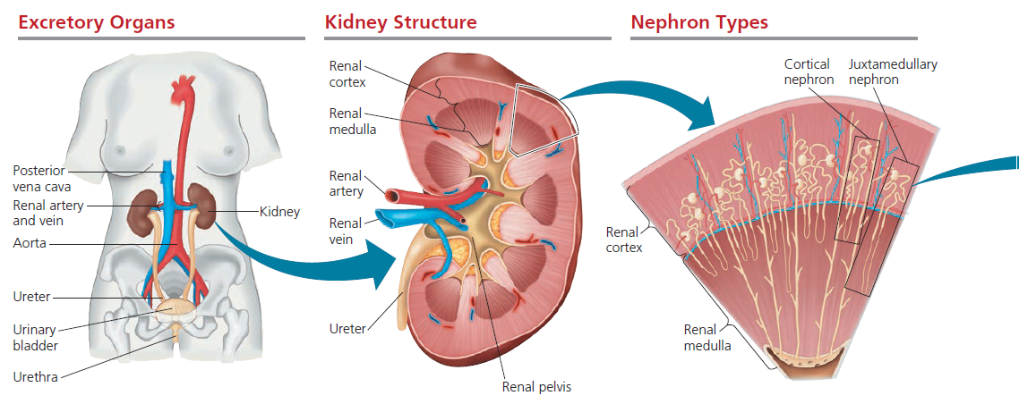
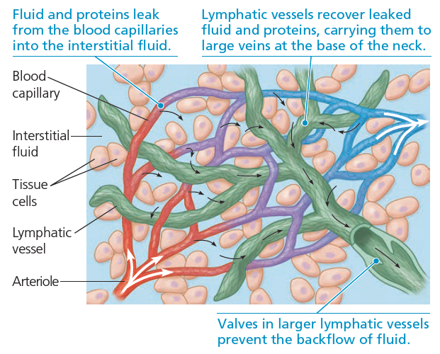
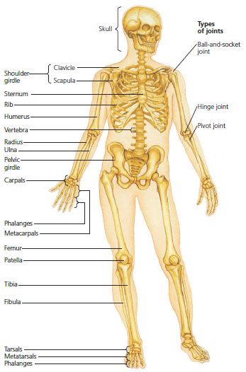
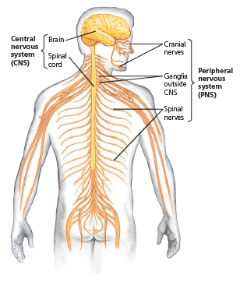
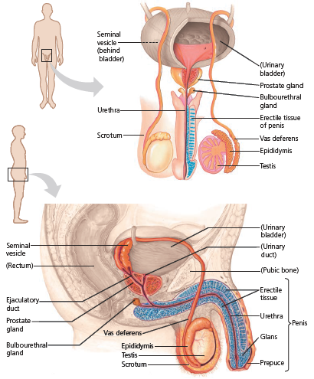
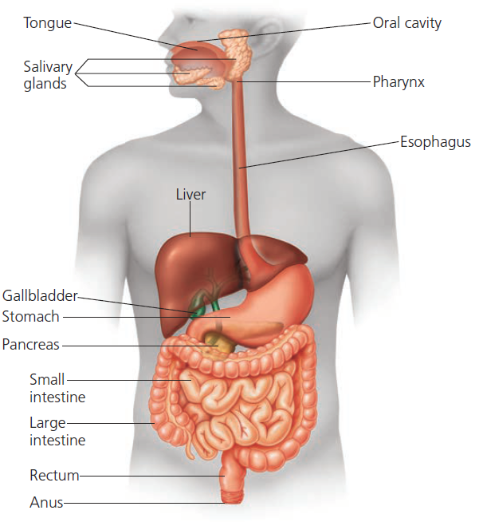
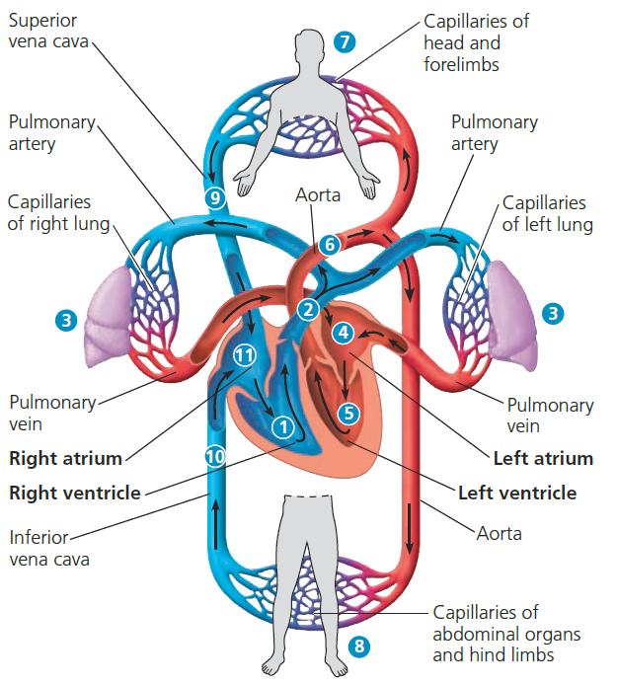
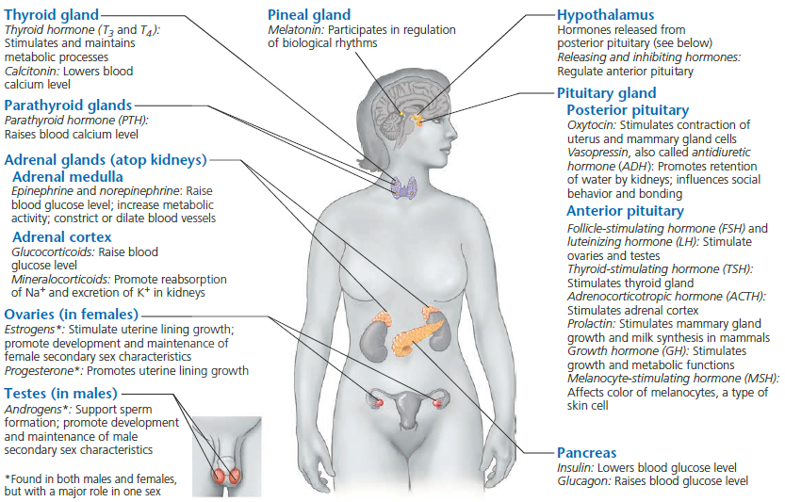
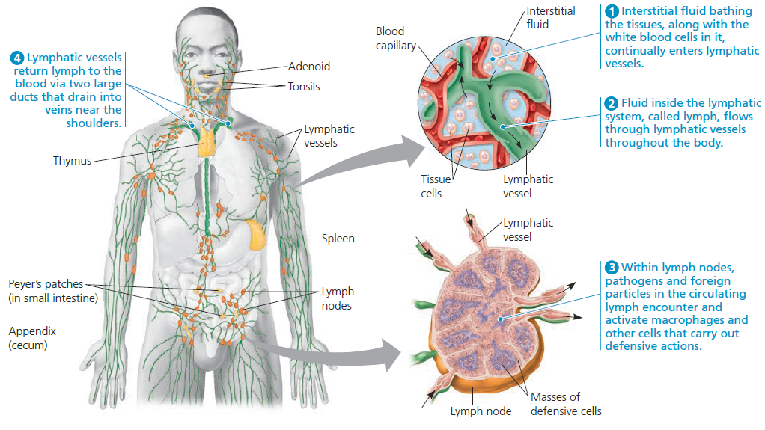
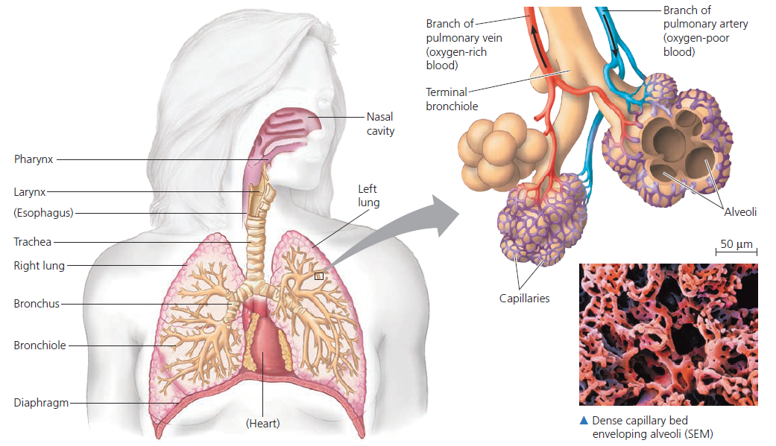
Human Body Systems

Slide 4
Homeostasis
The tendency of the body to maintain a relatively constant internal environment
Examples
  Body temperature (37 ℃)
  Blood glucose level (70-110 mg/mL)
  pH (7.4)
  Blood oxygen levels (ABG 80-100 mm Hg)

Slide 5
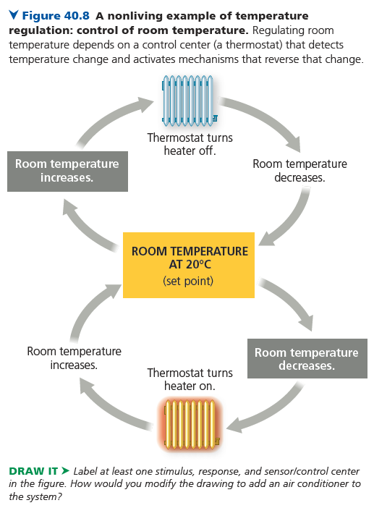
Homeostasis
Feedback Systems
Homeostasis may be disturbed constantly, so how do things stay in a “steady state”?
Components of feedback systems
  Sensor
  Control Centre
  Effector
https://www.youtube.com/watch?v=LSgEJSlk6W4&ab_channel=WhatsUpDude

Slide 6
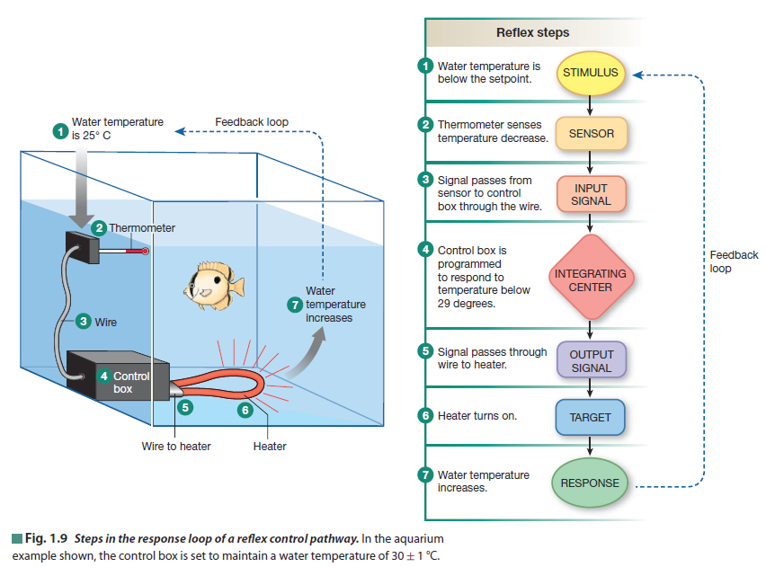
Homeostasis
Negative Feedback Systems
Mechanism of homeostatic response by which the output of a system reverses a change in a variable, bringing the variable back to within normal range
Example
  Body temperature

Slide 7
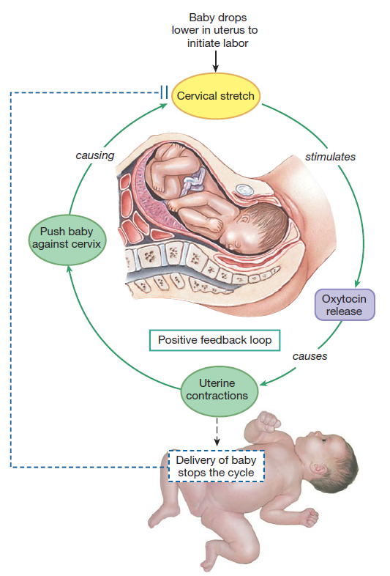
Homeostasis
Positive Feedback Systems
Mechanism of homeostatic response by which the output of a system strengthens or increases a change in a variable
Example
  Childbirth
https://www.youtube.com/watch?v=Iz0Q9nTZCw4&ab_channel=AmoebaSisters
https://www.youtube.com/watch?v=CLv3SkF_Eag&ab_channel=BozemanScience

Slide 8
Homeostasis
Sensor
A body structure that monitors and detects changes in the internal environment
Control centre
A body structure that sets the range of values within which a variable should be maintained, receives information from the sensor and sends signals to effectors when needed
Effector
A body structure that responds to signals from a control centre to effect a change in a variable

Slide 9
References
Carter-Edwards, T., Gerards, S., Gibbons, K., McCallum, S., Noble, R., Parrington, J., Ramlochan, C., Ramlochan, S. (2011). Biology 12. McGraw-Hill Ryerson Limited
Silverthorn, D.U. (2013). Human Physiology: An Integrated Approach. Pearson Education Inc.
Hillis, D.M., Sadava, D., Hill, R.W., Price, M.V. (2014). Principles of Life . Sinauer Associates, Inc.
Urry, L.A., Cain, M.L., Wasserman, S.A., Minorsky, P.V., Reece, J.B., (2017). Campbell Biology (11th edition). Pearson Education, Inc.

